Slide 1

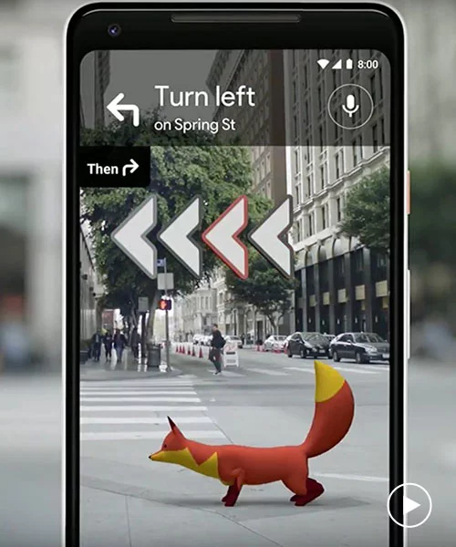



BEAT ATTENDANCE SOLUTION
Geotagging
Geotagging
Authenticate Constable

Slide 2
ALERT/SoS
SMS (to all members in a station)
CALL (last location and time)
REPORT
Beat Report with TIME and GEOTAGGING + Image/Video Upload
Fetch Details and Update of RS/MOB/HS
OTHER SOLUTIONS …

Slide 3
WORKFLOW
Mobile App
Scans Fingerprint
Mobile App
Location post
Augmented Reality-
Enter code from generated object.
Supervisor app
In map, beat point becomes green,
Beat done
Reports viewed
Reports Incidents
Photos,
Videos with
Description

Slide 4








1.ANDROID STUDIO
2.VUE JS
TECH STACK
3.FIREBASE
4.UNITY
6.GOOGLE API
5.VUFORIA

